Slide 1

Listening and Questioning Skills

Slide 2
Topics
Listening skills and how to demonstrate active listening during conversations
Understanding different questioning techniques
Using questions to fact find and find opportunities - probing
Using questions to build rapport
Using questions to gain commitment
How to use SPIN questioning effectively
Notes:
Welcome and agenda from Paul and Anita

Slide 3
What is Active Listening?
HEARING
is not the same as
LISTENING
Notes:
Michelle & Marilyn made this slide ☺

Slide 4
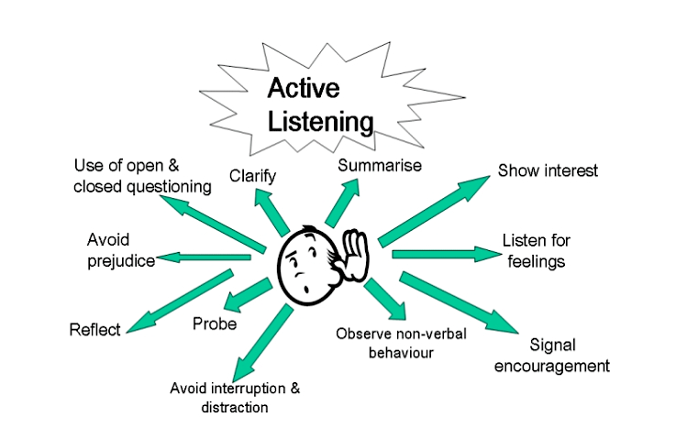
Discussion: Active Listening

Slide 5
Paraphrasing Techniques
Paraphrasing is not:
Repeating everything that person has said
Acting like a parrot and repeating everything verbatim
To paraphrase well, you should:
Paraphrase only when you need clarification or confirmation
An opportunity to express judgment (by speaking in a sarcastic tone, for example)
Put the statement in your own words, rather than using the speaker's words
Use introductory statements like, "Do you mean..." or, "What I'm hearing is..."
Refrain from making judgments, injecting your own thoughts, and offering your opinion

Slide 6
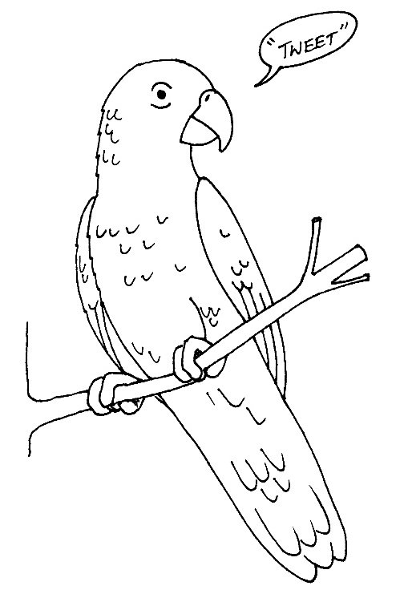
Echoing Techniques
Choose a word (or several words) from a customers statement and repeat it.
Or, use stems like:
  Really?
  Is it/are they?
  About…?
  What did she do?

Slide 7
Identifying Good Listeners
Write down the names of three people that you consider good listeners.
Do any of the three people fit into one of these categories?
Name of Person | Someone That You Like | Someone That You Admire | Someone That You Respect

Slide 8
Listening Tips
Make a decision to listen
Don’t interrupt people
Keep your eyes focused on the speaker and your ears tuned to their voice
Carry a notebook or start a conversation file on your computer
Don’t be afraid to ask the other person what they want from the conversation
Ask a few questions throughout the conversation
When you demonstrate good listening skills, that can be infectious

Slide 9

Questioning
“I Keep Six Honest Serving Men…”
I KEEP six honest serving-men
(They taught me all I knew);
Their names are What and Why and When
And How and Where and Who.
- Extract from Rudyard Kipling’s famous poem

Slide 10
Open & Closed Questions - Examples
Open | Closed
How are things going? | Is that ok with you?
What do you think we can do about this? | Can you do that?
How do you think we should solve the problem? | Does that make sense?
What is your opinion? | Did you understand everything?
Tell me more about your business? | Would you like to proceed?
Explain to me how that works? | Are you happy with my proposal?

Slide 11

Questioning Activity
What’s on the card?

Slide 12
Probing
Techniques
OPEN
Questioning funnel
PROBE
PROBE
LISTEN
To clarify or commit
CLOSED
C
H
E
C
K
You’ve understood

Slide 13

Probing (AR)
Notes:
Next slide plays audio automatically for 1 slide

Slide 14

Probing
Probing Questions
The objectives of asking probing questions are as follows:
To show interest and encourage the customer to keep talking
To increase the quality and quantity of information already gained
To confirm understanding of information already gained
Examples
Probing – “You say you weren’t happy with the service from your provider. What happened?”
Probing – “You mentioned regular contact. Explain how important is that to you?
Reflecting – “What I really want is better benefits with my policy”… “Better?”

Slide 15
SPIN
Questioning
S
Situation
P
Problem
I
Implication
N
Need-payoff

Slide 16
SPIN
S
Situation
”Tell me a bit more about your business?”
P
Problem
“What are the major issues you have with your existing broker?”
I
Implication
“When was the last time you benchmarked against your current broker?”
N
Need-payoff
“In other words, if we came up with a solution to address some of those concerns, you’d be interested, wouldn’t you?”

Slide 17
SPIN Questioning
Situation Question | Possible Customer Response | Problem Question
Do you use a broker or go direct to the insurer at the moment? | We currently use a broker but our account has been moved to their small business call centre in Scotland and we never hear from them. | Does this mean you don’t have a single point of contact?

Slide 18
SPIN Questioning
Implied Question | Possible Customer Response | Need-payoff
So you would prefer to have a local contact and be kept up to date in addition to just at renewal time? | Yes – It feels as if they only get in touch when they want our business again | So if you had a dedicated account handler who kept in touch throughout the year, you would prefer that?

Slide 19

Commit to Action
Please complete and hand back the ‘Commit to Action’ sheets
Thank you for your time

Slide 20
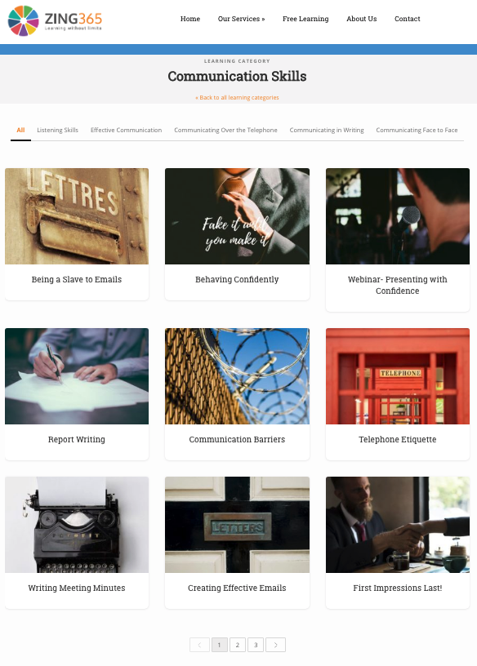

Visit Zing365 for more
www.zing365.co.uk

